Slide 1
Requirements Management with Use Cases
Module 5
Defining the System

Slide 2
Course Outline
0 - About This Course
1 - Best Practices of Software Engineering
2 - Introduction to RMUC
3 - Analyzing the Problem
4 - Understanding Stakeholder Needs
5 - Defining the System
6 - Managing the Scope of the System
7 - Refining the System Definition
8 - Managing Changing Requirements
9 - Requirements Across the Product Lifecycle

Slide 3
Defining the System: Overview
Problem
Problem Space
Needs
Solution Space
Features
Traceability
The Product To Be Built
Software
Requirements
Test Procedures
Design
User Docs
Notes:
In this module, we will focus on determining the features for our product and begin to develop the use-case model for our system.
Use this slide to explain where we are in the class.

Slide 4
Develop or Adopt Standard Templates
Benefits of Standardization
  Leverages the work of others
  Quicker ramp up, avoid reinventing the wheel
  Make sure things don’t fall through the cracks
  Everyone knows where to look for information
  Documents appear familiar and un-intimidating
  Documents are easier to read
Notes:
Module 5 - Defining the System
RMUC Instructor Notes
Each company should have a set of standard templates suited to fit their own needs.
There is a sample set of document templates included in the Student Handouts.
Each company should have a set of standard document templates suited to fit their own needs.
Point out the set of standard templates that are included in the Student Handouts.

Slide 5
Sample Requirements Specifications
Needs
Vision Document
Features
Supplementary Specifications
Software
Requirements
Use-Case Model
Test
Specifications
Design Specifications
User Documentation Specifications
Notes:
Here is the approach that we will use in this class for structuring our requirements and their relevant documentation. We will focus especially on the Vision Document and the Software Requirement Specification, or SRS. The Software Requirement Specification is primarily made up of use cases and supplementary specifications.
The Software Requirement Specification will be used to drive the specification of the lower level documents -- for test, design and user documentation. The test, design and user documentation will not be discussed in this course, but it is important to know that the requirements specifications will be input to that documentation.

Slide 6

The Vision Document
System-level document that describes the “Whats” and “Whys” of the product or application
Focus is on:
  User needs
  Goals and objectives
  Target markets
  User environments and platforms
  Product features
Vision
Document
Notes:
Module 5 - Defining the System
RMUC Instructor Notes
The Vision Document provides a high-level (sometimes contractual) basis for the more detailed technical requirements. There can also be a formal requirements specification. The Vision captures very high-level requirements (features) and design constraints. It gives the reader an understanding of the system to be developed. It provides input to the project-approval process, and is therefore intimately related to the Business Case. It communicates the fundamental "whys and whats" related to the project, and it is a gauge against which all future decisions should be validated.
In general, the Vision Document will be read by managers, funding authorities, workers in use-case modeling, and developers.

Slide 7
Roles of the Vision Document
Communicate between management, marketing, and the project team
Provide for initial customer feedback
Foster general understanding of the product
Establish scope and priority of high-level features
Record future features and ideas
A document that gets
“all parties working from the same book”
Notes:
Module 5 - Defining the System
RMUC Instructor Notes
The primary purpose of “any” document is communication. We should always be aware of who will be reading the document and ensure that they understand its content.
Start to stress here that the primary purpose of *any* document is communication!
If not, then why have it?
Who is the audience?

Slide 8
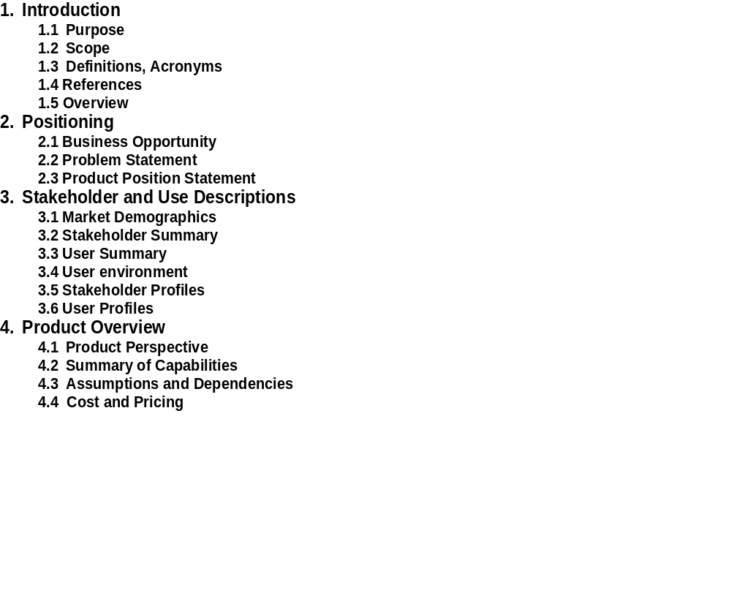
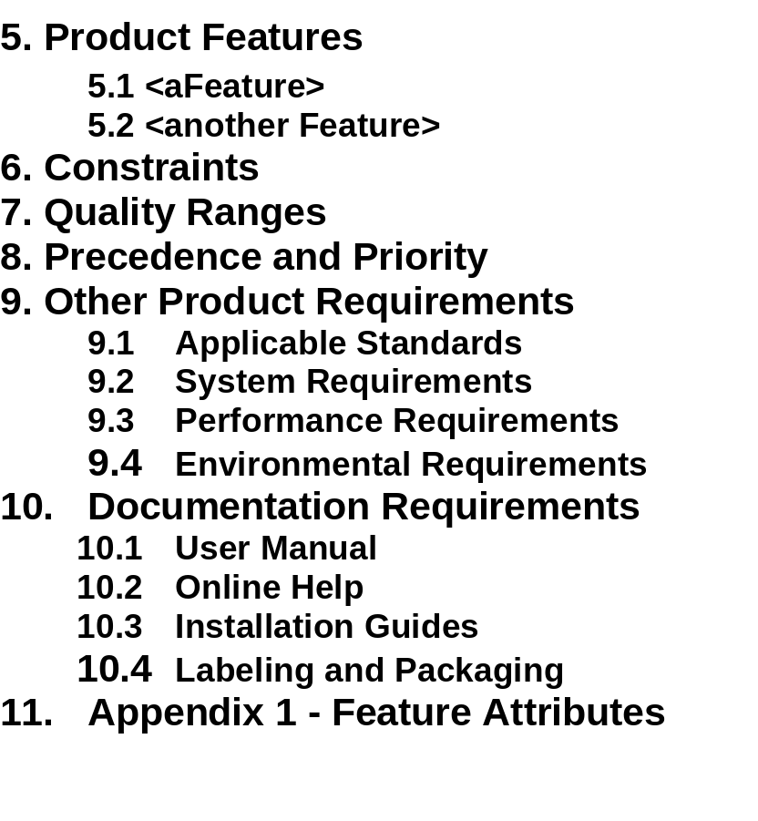
Vision Document: Template
Handout
TP: Vision Document Template
Notes:
A sample template for the Vision Document can be found in the student handouts.

Slide 9
Exercise: Section 2.3 Product Position Statement
Communicates Intent and Importance
For
(target customer)
Who
(statement of the need or opportunity)
The
(product name)
Is a (product category)
That
(statement of key benefits - that is -
compelling reason to buy)
Unlike
(primary competitive alternative)
Our
product
(statement of primary differentiation)
Hint: Use Problem (Analysis) Statement as a starting point!
Moore ‘91
Notes:
Facilitate development of the Product Position statement for the sample project that will be worked on in the class.
Sometimes we call the Product Position Statement an “elevator statement” because of the following scenario:
You are stepping into an elevator (have 2 minutes) with your V.P. and want to spark his interest in this product so that when the Vision Document shows up on his desk it will not be ignored.
The complete statement should fit on one page of the easel paper.
RECOMMENDED:
Whole-class exercise.
Estimated time: About 10 minutes.
Example:

Slide 10
Section 5: Product Features
A feature is a capability or characteristic of the system that directly fulfills a stakeholder need.
Examples
The Defect Tracking System will provide trending information to help the project manager assess project status.
The ATM will allow a customer to transfer funds between accounts.
The graphical user interface will provide context-sensitive help.
Notes:
These are the types of statements that come out in a brainstorming session about features.
Make a point that these are similar to the types of statements that came out in the brainstorming session earlier.
Point out that one definition of “feature” listed in Webster’s Dictionary is “an advertised benefit.” The types of items we will consider as features are those that could be advertised as benefits.
Each feature directly fulfills a stakeholder need. Often there are many lower-level software requirements that trace back to a single feature.

Slide 11
Section 11: Appendix 1 - Feature Attributes
Attributes
  Information about features
  Used to evaluate, track, prioritize, and manage
Appendix 1
  Defines the attributes to record for each feature
  For use in your requirements repository
11. Feature Attributes
  Status
    Proposed
    Approved
    Incorporated
  Benefit - How important is this to the customer/user
    Critical
    Important
    Useful
  Effort
  Risk
  Stability
  Target Release
  Assigned To
  Reason
Notes:
Module 5 - Defining the System
RMUC Instructor Notes
Information about feature attributes should be specified in the Requirements Management Plan. It is useful to repeat the information about feature attributes in the Vision Document, due to its wide audience.
Attributes are a key concept for requirements management. They can be used to ask management questions such as: “What features are critically important to the customer but are not yet approved?” Of course, you can only ask this question if you have defined the attributes Benefit and Status.
Explain that an attribute provides additional project information about each feature.
Use the example to show the importance of attributes for keeping track of and managing the features.
Discuss possible values of the “Benefit” attribute:
Mandatory/Critical = don’t do product without feature
(might want to distinguish between Safety Critical and Market Critical)
Important = potential loss of sales if omitted
Relevant = may not impact sales
Useful = state of the art, helpful
Relate the idea of feature attributes to the class project. What attributes we should record for features in the class project? Which features in our list of features (from the brainstorming exercise) would we consider to be critical?

Slide 12
For Product Version 2: The Delta Vision Document
Vision Document 1.0
General Information
Key User Needs
Key Features of 1.0
Future Features
Comprehensive Starting Point
+
Delta Vision Doc. 2.0
New Features for 2.0
Removed Features
Future Features
Change Information
For This Release
= The Whole
Product Definition
Notes:
Now we have the Vision Document defined for version 1.0 of our product. We’ve defined the requirements, done the design, and built Version 1 of the software. We are ready to begin developing Version 2. What do we do about the Vision Document when we start Version 2 of our product?
The approach suggested here is to make a “delta” Vision Document that only describes changes to the original Vision: the features added for Version 2, the features that have been removed, and the new vision of future features.
By using this approach, those who have worked with the project from the beginning (or are familiar with it) can just use the “Delta” document and not have to wade through information they already know. Someone new coming into the project can start back at the first document and follow its evolution. Also, since the general information and key user needs probably have not changed, there is no need to repeat them.
The main drawback of this approach is for the reader who is new to the project: now the reader must read 2 documents (Vision Document Version 1 and the Delta Vision) to get the whole story.
How do you handle Version 2 of your Vision Document?
Now we have the Vision Document defined for version 1.0 of our product. We’ve defined the requirements, done the design, and built Version 1 of the software. We are ready to begin developing Version 2.
What do we do about the Vision Document when we start Version 2 of our product?
Ask: What do you do now in your own companies?
There are many strategies for handling documentation for Version 2 of a product. Use this slide to stimulate discussion about ways to handle version 2, and the relative advantages of each approach.
The 2 most common strategies are:
1. The Vision Document for Version 2 is again a complete document, including the general information and key user needs. The advantage is that a reader gets the entire Vision for Version 2 of the product in a single document. The main drawbacks are that it is hard to tell what was added or removed, and there is a lot of duplication with the Vision Document for Version 1.
2. In the approach shown here the “Delta” Vision Document for Version 2 contains only the changes from Version 1. The advantage is that a reader can easily see the changes and need not wade through lots of “old” information. Since the general information and key user needs probably have not changed, there is no need to repeat them. The main drawback is for the reader who is new to the project: now the reader must read 2 documents (Vision Document Version 1 and the Delta Vision) to get the whole story.

Slide 13

Documents in the Use-Case Model
A Recycling Machine
Use-Case-Model Survey
- survey description
- list of all actors
- list of all use cases
Customer
Recycle Items
Operator
Print Daily Report
Recycle Items
- brief description
- flow of events
Change Refund Values
Manager
Print Daily Report
- brief description
- flow of events
Add New Bottle Type
Change Refund Values
- brief description
- flow of events
Add New Bottle Type
- brief description
- flow of events
Notes:
The important part of the use-case model is the text. Frequently, many people get the wrong idea of the word “modeling” and believe use-case modeling is just about drawing figures and arrows. The use case diagram is a wonderful overview but a very small part of the entire use-case model .
The documents in a use-case model include the Use-Case-Model Survey, which gives the overview of the use-case model; and a Use-Case Report for every use case. The use-case reports may actually be separate documents, or may be “chapters” in a single document.
You may want to look again at the sample ATM use-case model included in the student handouts: UC 1 and UC 3.
Now let’s leave the Vision Document and move on to discuss the documents in the use-case model.
Point out the relationships between the different reports and the use-case-model artifacts. There is a single Use-Case-Model Survey, which gives the overview of the use-case model. There is a “Use-Case Report” for each use case. These Reports may actually be separate documents, or may be “chapters” in a single document.

Slide 14
Use-Case-Model Survey: Template
Use-Case-Model Survey
  Gives a complete functional overview of the model
  Shows a system’s intended functions and environment
  May serve as a contract between the customer and the developers
  Is input to activities in analysis, design, and test
Use-Case-Model Survey
1. Introduction
    Purpose of the system
2. Survey Description
    Overview of the use-case model
3. Use-Case-Model Hierarchy
    The packages in the model, representing a hierarchy. For each package, give its
    Package name, brief description, role in the system, and what it contains:
Actors
    Name and brief description of each actor and its associations
Use Cases
    Name and brief description of each use case and its associations
4. Use-Case Diagrams
A list of all actors
A list of all use cases
Notes:
The Use-Case-Model Survey describes the use-case model comprehensively in terms of how the model is structured. Its main purpose is to list and briefly describe the actors and use cases.
A model may too large to view as a single unit. A package is a grouping mechanism to break your model into smaller pieces. A package may contain use cases, actors and relationships; and perhaps other, smaller packages. For example, one package may contain a particular actor and all the use cases that the particular actor can perform.
If you are using packages, the Use-Case-Model Survey will have a separate subsection in Section 3 for each package. Each subsection contains an overview of the package and the lists of Actors and Use Cases in the package.
If your model is small, then you may not need to use packages. Then Section 3 of your Use-Case-Model Survey would contain the lists of Actors and Use Cases in the entire model. For example, the Sample (ATM) Use-Case Model has no packages.
The Use-Case-Model Survey can be used to describe the entire use-case model at different stages:
During Inception, when you define the scope of the system
During Elaboration, when the use-case model is more stable
During Construction, when requirements are complete
This report is used by various people interested in the use-case model, such as the customer, users, architects, use-case authors, designers, use-case designers, testers, managers, reviewers, and writers.
The Use-Case-Model Survey is the overview of the Use-Case Model. Emphasize that its main purpose is to list and briefly describe the actors and use cases.
This is the first time we have mentioned “packages”. Explain, as in the student notes, that packages are simply a grouping mechanism that allows you to break your model into smaller pieces.

Slide 15
Section 2. Survey Description for Recycling Machine
The primary use case is Recycle Items, which represents the main purpose of the Recycling Machine.
The supporting use cases are:
  Print Daily Report, which allows an operator to get a report on how many items have been recycled, and
  Administer Deposit Item, which allows an operator to change refund value for a type of deposit item, or add new deposit item types.
Notes:
Here we see a survey description for the Recycling Machine.
For an additional example, see the Survey Description in the sample Use-Case-Model Survey documents for the ATM in the handouts:
“The Automated Teller Machine is a remote unit connected to the bank computer systems. The purpose of the system is to bring regular bank services closer to the customer and increase the working hours to around the clock. It is also important to decrease the amount of bank cashiers. An ATM withdraw is less expensive for the Bank than a withdraw from a teller.
“The ATM system requires that each bank customer has an ATM card and remembers his PIN code. The whole security of this system builds on the PIN code.”

Slide 16
Actor Properties in the Use-Case-Model Survey
Actor properties in the Use-Case-Model Survey include:
  Name
  Brief description:
    What or who the actor represents
    Why the actor is needed
    What interests the actor has in the system
    A few lines only
  Relationships
    Communication-associations to and from use cases
Actors also occur on diagrams showing how the actor interacts with use cases in the model
Notes:
This is the information used to describe each actor in the Use-Case-Model Survey.

Slide 17
Examples: Brief Description of an Actor
Customer
  The Customer collects bottles, cans, and crates at home and brings them back to the shop to get a refund.
Operator
  The Operator is responsible for maintenance of the recycling machine.
Manager
  The Manager is responsible for questions about money and the service the store delivers to the customers.
Notes:
Note: The Actor name is a “label”, which can be used to refer to it throughout the model. The brief description should clarify any ambiguity that the name might suggest.
Suggestion: Try to avoid an actor called “User” -- try instead to figure out the role of that particular user.
All actors are from the recycling machine model.
Emphasize that the actor name is a “label” which can be used to refer to it throughout the model. The brief description should clarify any ambiguity that the name might suggest.
Suggestion: Try to avoid an actor called “User”, rather try to figure out what is the role of that particular user.

Slide 18
Use-Case Properties in the Use-Case-Model Survey
Use-case properties in Use-Case-Model Survey
  Name
  Brief description
    Describe the role and purpose of the use case
  Relationships between the use case and actors
Describe the use case only briefly
  It will later be fully described in the Use-Case Report
Notes:
These are properties of the use cases that are included in the Use-Case-Model Survey:
Name: The name of the use case.
Brief Description: A brief description of the role and purpose of the use case.
Relationships: The relationships, such as communicates-associations, uses-and extends-relationships, in which the use case participates.
The use case has other properties, too, which are included in the Use-Case Report, which we will discuss in Module 7: Refining the System Definition.
On an easel paper, start making a list of the use-case properties, so you can refer to them throughout the course. Here are the use-case properties that are included in the Survey. Further properties of the use case will be specified in the Use-Case Report.

Slide 19
How Should I Name a Use Case?
Each use case should have a name that indicates what is achieved by its interactions with the actor(s).
Examples of variations:
  Recycle Items
  Receive Deposit Items
  Receiving Deposit Items
  Return Deposit Items
  Deposit Items
Which variations show the value to the actor? Which do not?
Which would you choose as the use-case name? Why?
Notes:
A good rule of thumb (but not dictated by any standard) is to attach the actor’s name (of the primary actor) at the beginning of the use-case name and see if it makes sense.
Ask, “What does the actor do while using the system?”
Point out the ambiguity of some of these names, for example,
“Receive Deposit Items” -- who is doing the receiving? The customer? The recycle machine?
The best answer here would probably be to “Recycle Items.” But is this really what is happening? (Perhaps from the customer’s perspective…)
What about “Deposit Items”?
Try to seed some discussion in this area. It is a good idea for each company to have a standard of how they will name their use cases.
The main thing is to BE CONSISTENT!

Slide 20
Examples: Brief Description of a Use Case
Recycle Items
  The user uses this machine to automatically have all the return items (bottles, cans, and crates) counted, and receives a receipt. The receipt is to be cashed at a cash register (machine).
Add New Bottle Type
  New kinds of bottles can be added to the machine by starting it in ‘learning mode’ and inserting 5 samples just like when returning items. In this way, the machine can measure the bottles and learn to identify them. The manager specifies the refund value for the new bottle type.
Notes:
Two samples from the recycling machine.

Slide 21
Use-Case Diagram
A Recycling Machine
Customer
Recycle Items
Operator
Print Daily Report
Change Refund Values
Manager
Add New Bottle Type
Shows all actors and use cases in the model and the relationships between them.
Notes:
Often a global use-case diagram will be included in the Use-Case-Model Survey to give a graphical overview of the system.
The use-case diagram should include all use cases, actors, and their relationships.

Slide 22
Interaction Between Actors and Use Cases
Communicates-Association
  A line or arrow between an actor and a use case indicates they interact by sending signals to one another
Register Car
Clerk
Print Car Report
A Car-Registration System
Notes:
A communicates-association between an actor class and a use-case class indicates that their instances interact. The communicates-association need not be directed.

Slide 23

What Does the Arrow Indicate?
Alarm, bottle stuck
Problem fixed
Press start button
Machine ready
First bottle
Machine ready
Next bottle
Recycle Items
Customer
Operator
Machine ready
Next bottle
Receipt
Print receipt
Lines and arrows represent two-way dialog
UML: Use arrow if needed for clarification
Arrows show who initiates the use case
Notes:
The UML standard recommends the use of an arrow head if needed for clarification. That leaves a lot of room for interpretation! Many styles of using arrow heads are in common use.
In this class, we will use arrowheads to indicate the actor that initiates the use case (pointing from the actor toward the use case). A simple line will be used between the use case and actors who participate in but do not initiate a use case.
Whatever standard you adopt for the use of an arrow head, it should be clearly specified in the Use-Case-Model Guidelines for this project.

Slide 24
A Set of Sequences of Interactions
Each use case describes a set of
sequences of interactions
A System
A sequence of interactions of the system with actors that will achieve a result of value for an actor (sometimes designated as the primary actor)
Notes:
A use case describes “complete” flows through the system until the resulting value is achieved.
Often the sequence of interactions involves several actors. But one actor receives the result of value. The actor receiving the value is sometimes called the primary actor.
The actor receiving the value is most often the one that initiated the use case, but this is not necessary. However, the use case must result in an observable result of value for some actor(s).
Stress here that each use case describes a *complete* flow through the system until the resulting value is achieved.

Slide 25
A Scenario: One Path Through a Use Case
A use case can have many instances
A scenario is a use-case instance
  A specific sequence of actions
Customer
Recycle Items
Operator
Notes:
A use case instance is simply one particular flow of events in the system. This is also called a scenario.
The use case defines a set of related scenarios.

Slide 26
Useful Questions for Identifying Use Cases
What are the tasks of an actor?
Does the actor need to be informed about certain occurrences in the system?
Will the actor need to inform the system about sudden, external changes?
Does the system supply the business with the correct behavior?
Can all functional requirements be performed by the use cases?
What use cases will support and maintain the system?
What information must be modified or created?
Notes:
The best way to find use cases is to consider what each actor requires of the system. Go through each actor and identify the needs of each particular actor.
For an information system, a business model may provide valuable input, since it will probably clarify how the system is to be used.
There is not only one single use-case model possible for a system. You could develop alternative models and choose the one you prefer.
Try to keep all use cases at approximately the same level of importance. The above questions may help get the right granularity (refer also to the definition of a use case):
Would you ever want to perform a particular activity as an end result in itself?
Are there any activities that should be kept together so you can review, modify, test, and document them together?
If a use case turns out to be too complex, you may want to split it (a use-case report significantly longer than 10 pages may be a candidate).
When you have made your first list of use cases, verify that all required functionality has been treated.
Give each use case a name that indicates what an instance of the use case does. To be comprehensible, the name may have to consist of several words.
This is an important slide because it gives questions for identifying use cases. Suggest that the students mark this slide (tick the corner or place a sticky note) for easy access later.

Slide 27
Special Use Cases Not to Forget
System start and stop
Maintenance of the system
Maintenance of information
  Example: automatic jobs checking the database
  Usually addressed in later iterations
Adding new functionality to the running system
  Important for real-time systems with no down time
Porting the running system to a new environment
  Use cases where actor is the development organization
Notes:
Don’t forget to include use cases for automatically scheduled events. For example, a time-initiated job may run the payroll at midnight on the last day of every month. For another example, a time-initiated job may synchronize duplicated information across multiple databases at midnight every night.
Use cases that concern automatically scheduled events are usually initiated by a special actor, the Clock.

Slide 28
Exercise: Course Registration System
At the beginning of each semester, the RU Registrar’s office will provide a list of courses to all students through a new on-line registration system. Information about each course, such as professor, department, and prerequisites, will be included to assist the students in making an informed decision.
The new system will allow students to review available courses and select four of them for the coming semester. In addition, each student will indicate two alternative choices, in case a course becomes filled or canceled. No course will have more than ten students. No course will have fewer than three students. Should a course have fewer than three students, then the course will be canceled. If there is enough interest in a course, then a second offering will be established.
Notes:
The purpose of this exercise is to practice looking at a fairly complex problem description and to determine the actors and use cases that might be needed. Write your solution in the form of a use-case diagram.
This slide and the following slide describe a course registration system. First, look at the “Useful Questions When Identifying Actors” (on page 3-21) and spend 5 minutes identifying actors. Then, look at the “Useful Questions In Identifying Use Cases” (on page 5-26) and spend 5-10 minutes trying to identify use cases for this system.
REOMMENDED:
Small group exercise (3 to 5 people) followed by whole-class discussion.
Estimated time:
20-30 minutes to make diagrams.
10-20 minutes for whole-class discussion.
In small groups, students can talk through their decisions about what is/is not a use case. But it can also be run as an individual or whole-class exercise.
Have each group write their use-case diagram on easel paper. You can post the papers together on a wall and compare the solutions.
Note that the requirements are ambiguous (on purpose). Don’t let them get too deeply into arguing about how to run the registration -- tell them to pick one way and focus on how to model that way.
Ask students not to turn the page -- there is a sample solution there. Once they have completed theirs, they may want to then go ahead and compare. NOTE: The sample solution is not necessarily the best, but it is a good start for discussion.
There are usually some very interesting points for comparison. For example, there are at least 4 ways that the billing information may be sent to the billing system:
1. The registrar initiates a Transfer Billing Use Case (as in the sample solution).
2. The clock/father time initiates a Transfer Billing Use Case at the end of the registration period.
3. The billing system initiates a Transfer Billing Use Case when it is ready for the information.
4. There is no separate Transfer Billing Use Case. Billing info is transferred whenever a student registers/alters registration, as a step in the “review and select” and “alter course selection” use cases.

Slide 29
Course Registration System (cont.)
Professors must be able to access the on-line system to indicate which courses they will be teaching. They will also need to see which students have signed up for their courses.
The registration process will stretch out over three days. The first day will be freshmen orientation and registration. All other students will arrive on the second day of the semester to register. The third day will be used to resolve any outstanding course assignment conflicts.
Once the course registration process is completed for a student, the registration system sends information to the billing system so the student can be billed for the semester.
As a semester progresses, the students must be able to access the on-line system to add or drop courses.
Notes:
Continue to identify use cases and actors.

Slide 30



Course Registration System: Sample Solution
Review and
select courses
Assign and
Alter Staff
Register and alter
Student information
Registrar
Student
Alter course
selection
Resolve registration
conflicts
Billing
System
Alter course selection
after registration period
Get class list
for a course
Transfer billing information
Enter courses
for the new semester
Professor
Notes:
Here is a sample (not necessarily optimal) solution, which brings up a lot of questions that will need to be answered by the customer or user:
What changes are you going to make to the bill if someone cancels three weeks before the start of a course? Is it due to medical reasons, such as a broken leg?
What if a course suddenly in the middle of the semester is under-booked? Is it then canceled?
What does the resolve process look like? How does the Registrar inform the professor that an extra offering for a course is needed? There are a lot of question that have to be asked in this case. This is just a starting outline.
‘Add course’ and ‘Drop course’ should not be specified as separate use cases. They are lower level functions within other use cases.
(See also the notes for running the exercise, on the first slide of the Registration System exercise)
This is not necessarily the best solution, but it is good for stimulating discussion.
Other questions to address:
Are the use cases too small? For example, should we combine “Alter course selection” and “Alter course selection after registration period” and have an alternative flow for after the registration period?
Does the diagram cover all activities? For example, in which use case do you think canceling too-small classes is done?
How do you know what is done in each use case? [Answer: You don’t know, from the diagram. ] This is a good lead-in to developing the textual description and flow of events.

Slide 31
Course Registration: Sample List of Features
The Course Registration System shall provide the ability to
  Create and alter a list of available courses (including professor, department, and prerequisites)
  Resolve course conflicts and cancel unfilled classes
  Send billing information to the billing system
  Register for courses, alter course selections, and drop/add courses after the course registration period
  Indicate desired teaching assignments
  Retrieve a list of courses a professor is teaching
  Retrieve a list of students in a course
The Course Registration System requires appropriate record keeping and security
Notes:
Here is a sample list of features for the Course Registration System. The list of features shows exactly what the system to be built will do. The features will be listed in the Vision Document.
Note that much of the detail is left out so that we can see a relatively concise list of features. As we continue to develop the requirements in Module 7, we will discuss how to write the detailed software requirements.
Here is a more extensive example of features. It is offered here so that students can see a bigger example of a list of features.
Also use this slide to prompt a discussion about the contrast between features and use cases. Some questions to prompt the discussion:
What is similar between the use cases and the features? [Answer: System functionality]
What is different about the perspective on the functionality? [One of many answers: Features are described from the system perspective, use cases are named from the user perspective]
What items are missing from the list of features that are present in the use-case model? [Some answers: The actors, and the communicates-associations]
What is the advantage of having a list of features?
What is the advantage of having a use-case model?
What is the advantage of having a list of features AND a use-case model?

Slide 32
Avoiding Functional Decomposition
Symptoms
  Small use cases
  Many use cases
  Difficulty understanding the model
  Names with low-level operations
    Names with “operation” + “object”
    Names with “function” + “data”
    For example: “Insert Card”
Corrective Actions
  Search for larger context
    Ask “Why are you building this system?”
  Put yourself in the user’s role
    Ask “What does the user want to achieve?”
    Ask “What value will the use case add?”
Notes:
Use cases are not functional decomposition. We want to avoid functional decomposition. Use cases describe the complete usage of the system to achieve a task.
“Small” names are usually a symptom of too small use cases -- tiny things that are operations. Nobody understands what the system can do for them by reading a lot of small, tiny bits that are not in context or in order.

Slide 33
Exercise: Describing the Use-Case Model
1. Review the information you have gathered so far on your class project:
  Stakeholders, Actors, and Problem Statement (M. 3)
  Features, Use Cases, and Priorities (Module 4)
  Product Position Statement (Module 5)
2. Now create a diagram of
actors and use cases:
  Identify actors and use cases
  Use lines or arrows to show the communicates-associations
  Write a name and brief description of each use case and actor
  Use easel paper so you can present your solution to the rest of the class
Notes:
Use your class project for this exercise. The deliverables will be:
A use-case diagram, drawn on easel paper
Name and brief description for each actor, written down for discussion but not displayed on easel paper
Name and brief description for each use case, written down for discussion but not displayed on easel paper
Use the class project for this exercise (or perhaps even a variation on the recycling machine).
Create a list of concepts, similar to a glossary, during the exercise.
Let the class work in groups.
Post the use-case diagrams on a wall. Let each group present their solution. It is important that you as the teacher are interested in their solution.
RECOMMENDED
Small group exercise followed by whole-class discussion.
Estimated time:
20-30 minutes for each group to do its work.
10-20 minutes for discussion and comparison.

Slide 34
Describing a Use Case: Step-by-Step Outline
(Usually just handwritten at this point)
Recycle Items
Brief Description
  The user uses this machine to automatically have all the deposit items (bottles, cans, and crates) counted, and receives a receipt. The receipt is to be cashed at a cash register
Outline for Flow of Events [Basic Flow, step-by-step format]
  1. The customer presses the Start-Button.
  2. The customer inserts deposit items.
  3. The system checks the type of the inserted deposit items.
  4. The system increments the day’s total of the types
  of items received.
  5. The customer presses the Receipt-Button.
  6. The system prints out the receipt.
Handout
UC 2 (ATM)
Notes:
The example of a step-by-step outline example is from the recycling machine example. Note how it gives the basic events in outline form. Later, we will fill in the details.
Now look at Handout UC2, the sample step-by-step outlines in the ATM example. The outlines are not official documents, but a start toward developing a document. The outlines would probably be sketched on easel paper at a Requirements Workshop.

Slide 35
Identify Alternative Flow of Events
Purpose:
  Find all possible scenarios for the use case
  List all questions to ask the user
Procedure:
  Work on paper with the users
  Ask - what may go wrong?
  Ask - what may not happen?
  Ask - what kind of resources can be blocked?
  Enumerate them A1, A2, A3, and so on
  You can describe them in detail, but usually it is enough to just identify them
Notes:
Alternative flows describe how the system should behave when things go wrong or when unusual things happen. Alternative flows are important, among other reasons, for determining the system architecture.
When working on the alternative use cases, questions regarding the behavior of the system are bound to surface. List these questions and have the users answer what the system is supposed to do, and how they expect to interact with the system in each scenario. Understanding the alternatives is an important step in clarifying the requirements.

Slide 36
Use Case: Different Flows of Events
One Basic Flow
Happy-Day Scenario!
Many Alternative Flows
  Regular variants
      Example: Withdraw Cash
      from Savings or Checking
  Odd cases
      Example: Withdraw Cash
      over a million dollars
  Exceptional (error) flows
      Example: Cash bin is empty
Notes:
The description should cover all the flows, the normal as well as the alternative and exceptional ones. Structure the description in such a way that it is easy to follow the different flows and to be able to understand what happens when.
Use lots of examples to illustrate the differences between the types of alternative flows. Point out that there is a different question to identify each type.
“What variations or options do we need to consider?”
“What unusual circumstances must be handled a bit differently?
“What can go wrong?”
The point is to be able to identify all of the alternatives needed in a use case.

Slide 37
Exercise: Write a Step-by-Step Outline
For each of the use cases agreed upon in your use-case model, write a step-by-step outline for the flow of events.
Use case name
Brief description
Basic Flow
1. First step
2. Second step
3. Third step
A1 Alternative flow 1
A2 Alternative flow 2
A3 Alternative flow 3
Notes:
Use the ATM Sample step-by-step outline as an example of the level of detail that should be attained. Remember, this is just a “brief” step-by-step outline to help understand what functions are contained in the use case. We will further describe these steps in Module 7, Refining the System Definition.
Have them work in the same groups that they used for the last exercise.
Before you break into groups, decide which uses cases to outline. Pick from the use-case diagrams that they did in the last exercise. You can let each group pick different use cases (to get more coverage of the class project) or you can pick the same ones for all groups (to allow comparison of different ways of handling the same use case). I usually have them do the same ones so that we can compare.
Have them write their outlines on notebook paper, and (if possible) make copies for the entire class.
How many use cases should each group outline? It depends on the amount of time you have available. I often limit it to one use case per group. Two or three per group is better, if you have time.
RECOMMENDED:
Small group exercise followed by whole-class discussion.
Estimated time:
20-30 minutes to work in small groups.
10-20 minutes for reading the outlines and discussion with the full class.

Slide 38
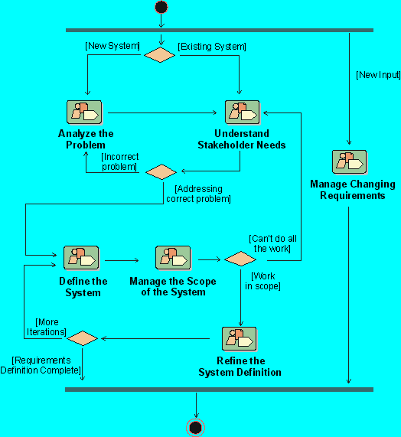
RUP Workflow Detail: Define The System
Notes:
Where does the Define the System workflow detail fit in our development process? The workflow details in the Rational Unified Process represent the steps we may take while developing the initial requirements for the system we are building. In this module, we discuss the activities to accomplish Defining the System.
Where is this done in your own software development process?

Slide 39
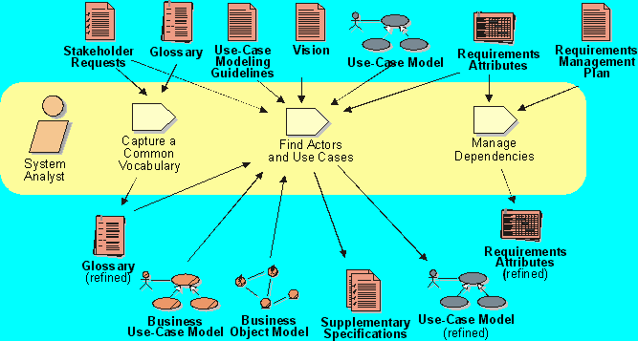
RUP Workflow Detail: Defining The System
Notes:
The purpose of this workflow detail is to:
Align the project team in their understanding of the system
Perform a high-level analysis on the results of collecting stakeholder needs
More formally document the results in models and documents
Typically, the Defining The System workflow detail is only performed in iterations during the Inception and Elaboration phases.
Problem Analysis and Understanding Stakeholder Needs create early iterations of key system definitions, including the Vision Document, a first outline to the use-case model, and the requirements attributes. In Defining the System, you focus on identifying actors and use cases more completely, and add supplementary specifications.

Slide 40
Review: Defining the System
1. What are some benefits of standardizing documentation?
2. What is the primary purpose of a Vision Document? What are some other purposes?
3. What is a product feature?
4. What is a feature attribute? How can attributes be used?
5. What is a use case? What is an actor?
6. Which properties of actors and use cases are specified in the Use-Case-Model Survey?
7. How are use cases and actors related?
8. What does the direction of the communicates-association arrow show?
9. What is a scenario?
10. What are some questions that help identify use cases?
Notes:
1.
2.
3.
4.
5.
6.
7.
8.
9.
10.
Use these questions to monitor the students’ level of understanding and to help them review.
Tell them they can look back through the material to get the answers.
Give them time to answer. Don’t be afraid to stand quietly while they look up the answer.

